Slide 1



TECH TITANS
FATALITIES IN ISR-PSE CONFLICT
2000-2023
FUTURENSE TECHNOLOGY

Slide 2



JAIN(DEEMED TO BE UNIVERSITY)
DURGAM NAGA DEERAJ REDDY
22BTRAD013
Meet Our Team
ESHITHA KATYAL
22BTRAD014
JEYAPATHY M
22BTRAD016
TECH TITANS

Slide 3

Agenda
1 | About the Conflict
2 | Government’s Role
3 | Insights from dataset
4 | Conflicts during Analysis
5 | Conclusion

Slide 4


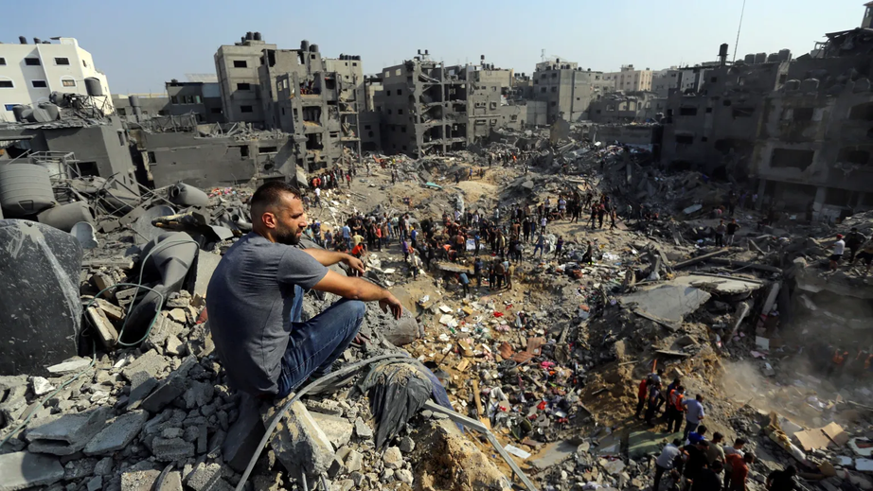
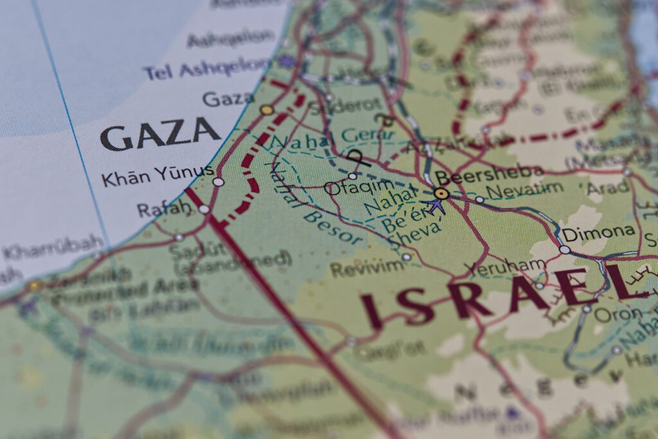
INTRODUCTION
The Israel-Palestine conflict began in the early 20th century, rooted in competing Jewish nationalist and Arab nationalist movements.
Post-WWII, the UN's partition plan led to Israel's establishment in 1948, sparking ongoing conflict over territory, national identity, and sovereignty, punctuated by wars, peace efforts, and uprisings.
The conflict continues with cycles of violence, attempts at negotiation, and significant political shifts within both Israeli and Palestinian societies.
TECH TITANS

Slide 5


METHODOLOGY
As per the UN reports, NGOs, government data of both Israel and Palestine:
UNRWA focused in providing assistance protection for Palestinian refugees.
Israel government concentrated on security incidents, casualties, legal actions and policy decisions.
Palestinian authority and government in Gaza issue reports through agencies, covering similar aspects including Israel policies.
International and local NGOs focused on daily life conflicts, legality of actions taken on both sides and personal stories of those who were affected.
TECH TITANS

Slide 6
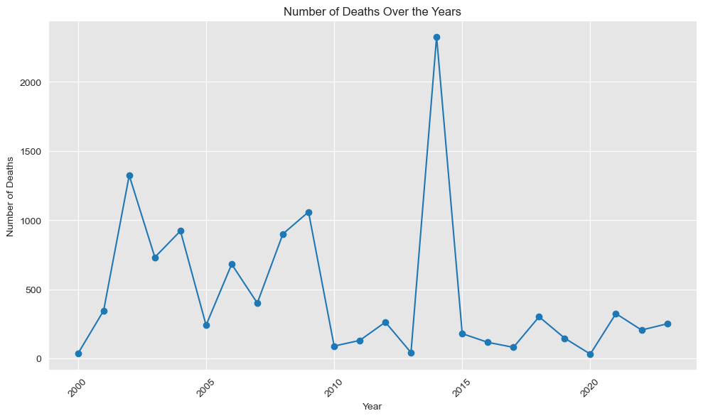
OUR ANALYSIS
GOING BY YEARLY TRENDS
1948-2000
1600, 6400-6700 Casualties
2008-2009
6400-6700 Casualties
2023
Civilians were targetted and killed at unprecedented scale
TECH TITANS

Slide 7



CHALLENGES IN DATA
Discrepancies and Complexity in Dataset
# 1
# 2
# 3
While analyzing the mortality rate during the Israel-Palestine conflict from 1948 to 2000 presented us with numerous challenges.
During the analysis of the fatalities during the Israel-Palestine conflict posed challenges, particularly in distinguishing between civilians and military personnel.
Verification of accurate data on casualties was difficult due to discrepancies between Israel, Palestinian and International reports.
TECH TITANS

Slide 8


CONCLUSION
During our analysis, we encountered numerous challenges and discrepancies while exploring the dataset spanning from 2000 to 2023, excluding the period from 1948 to 2000, for the Israel-Palestine conflict.
There is urgent need for international intervention to alleviate human suffering, protect civilians, and promote peace and stability in the region.
TECH TITANS

